Slide 1
Chapter 26 The Electric Field

Slide 2
What is a Field?
Q
q
F

Slide 3
What is a Field?
Q
The distribution of a physical quantity, represented either as a map or a scalar function of space coordinates, is called field.

Slide 4
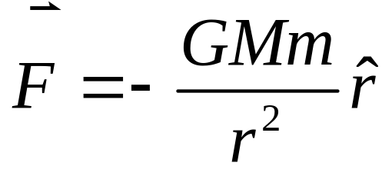
M
m
F

Slide 5
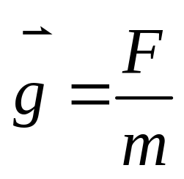
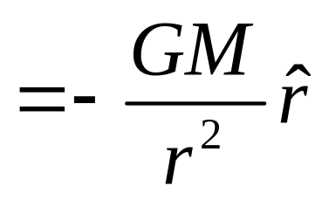

M
Gravitational field
Its direction gives the direction of the gravitational force at that point and its magnitude indicates the “strength” of the gravitational effect at that point.
1 Action at a distance
mass A mass B
2 Field Mediation
charge A Electric Field charge B
mass A field mass B
charge A Electric Field charge B
Electric field mediates electrostatic interaction.

Slide 6
Technically, by introducing “Electric field” in electrostatics, determination of the Coulomb force between the charges is reduced to 2 separate problems:
1. Determine the electric field established by the first charge distribution at every point in space.
2. Calculate the force that the field exerts on the second charge distribution placed at a particular region in space.

Slide 7

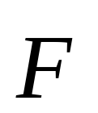
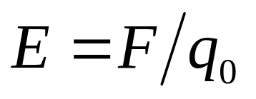
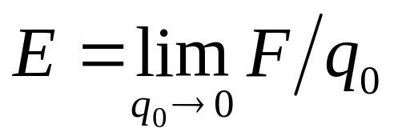
Electric Field :
Each charge distribution sets up an electric field in its surrounding space.
q₁
P
The electric field generated by a collection of charges is defined as,
q₀
q₂
q₃
q_{N}

Slide 8
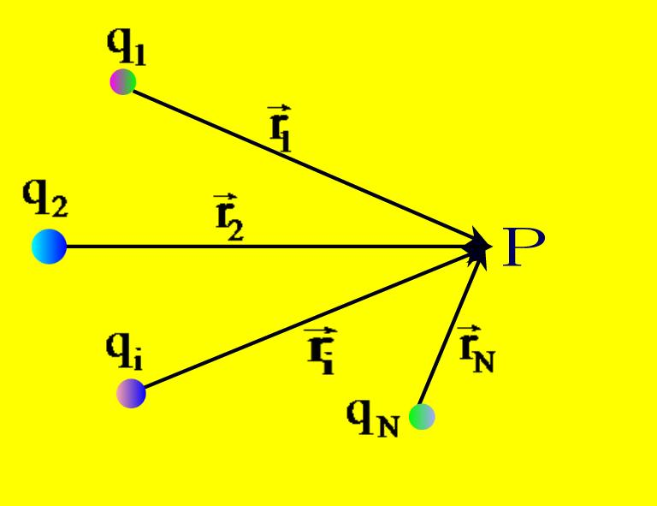
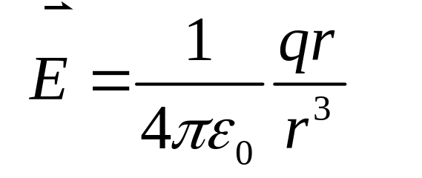

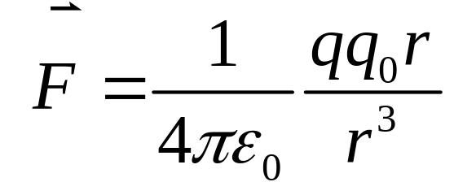
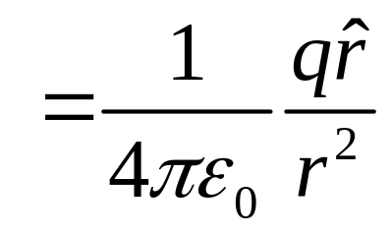
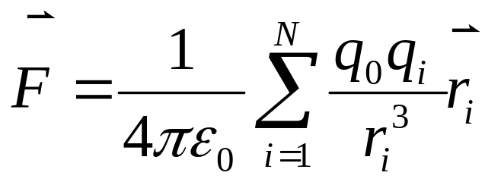
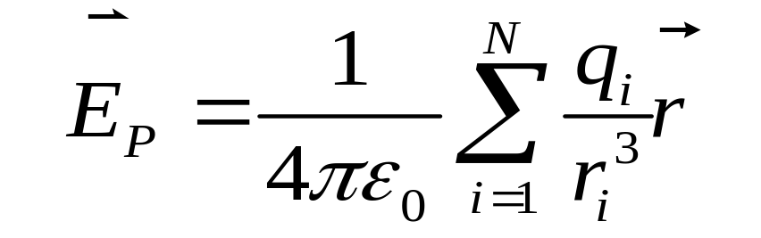
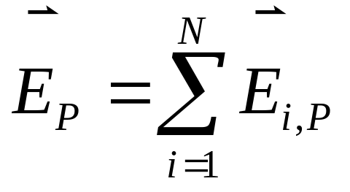
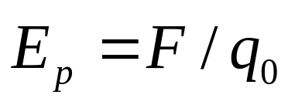
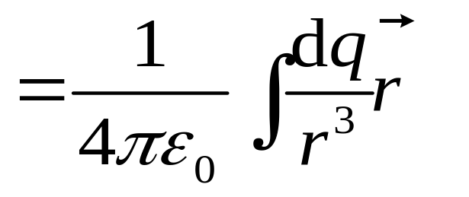
The Electric Field of Point Charges
P
1. A single point charge:
q
This formula is very simple but is extremely important in electrostatics.
2. A group of point charges
Electric Field of Continuous Charge Distribution

Slide 9
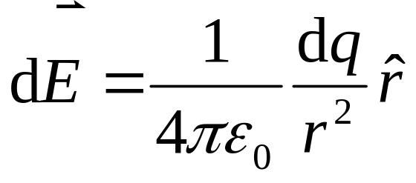
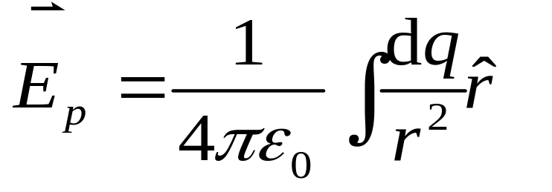
dE
r
p
Q
dq
Electric Field of Continuous Charge Distribution

Slide 10
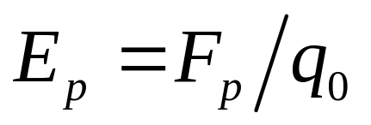
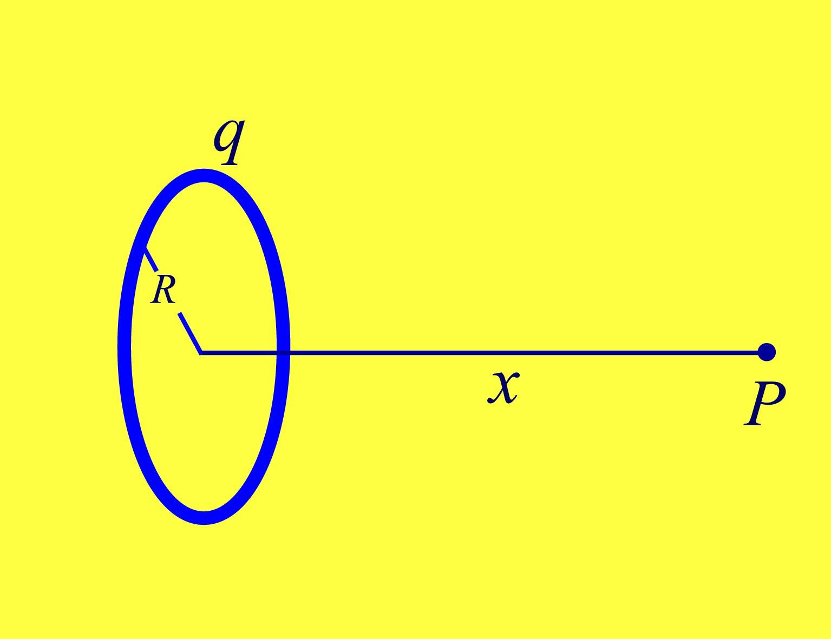

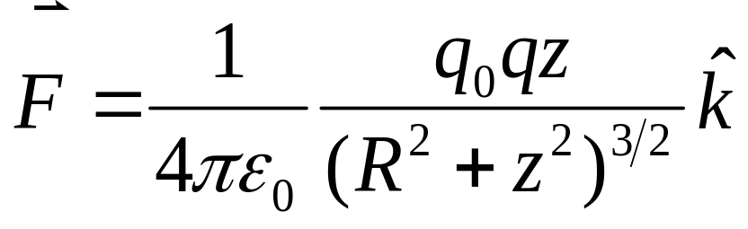




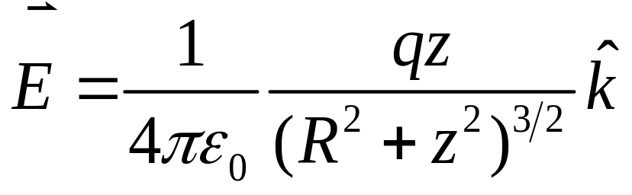


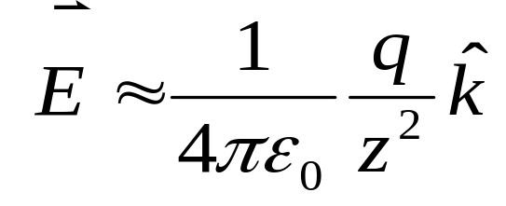

Example — a Ring
dq

Slide 11
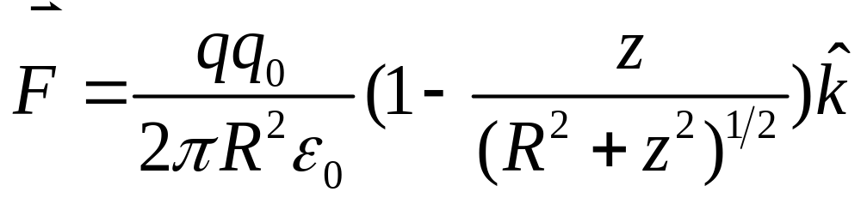
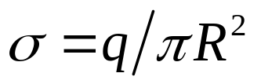
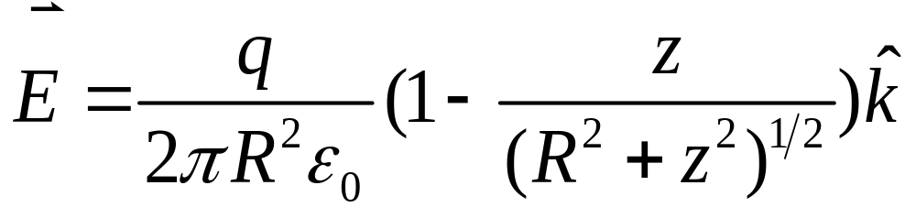

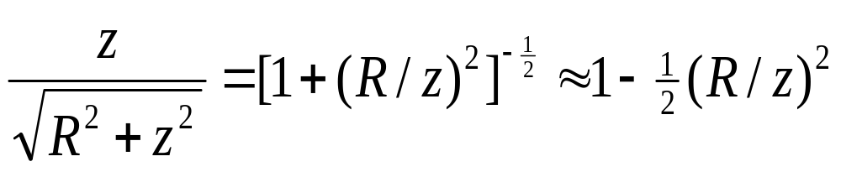
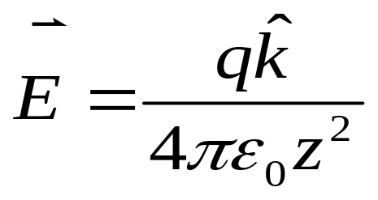
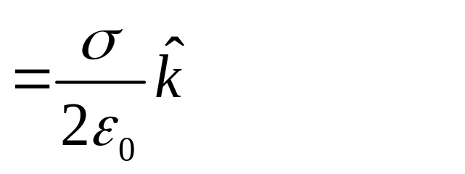
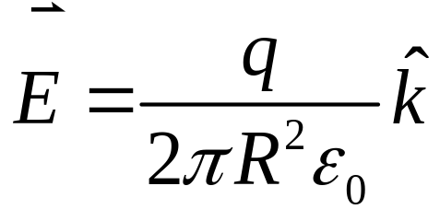

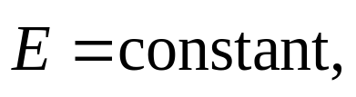
Example — a Disk
z >> R
( charged disk becomes a point charge . )

Slide 12
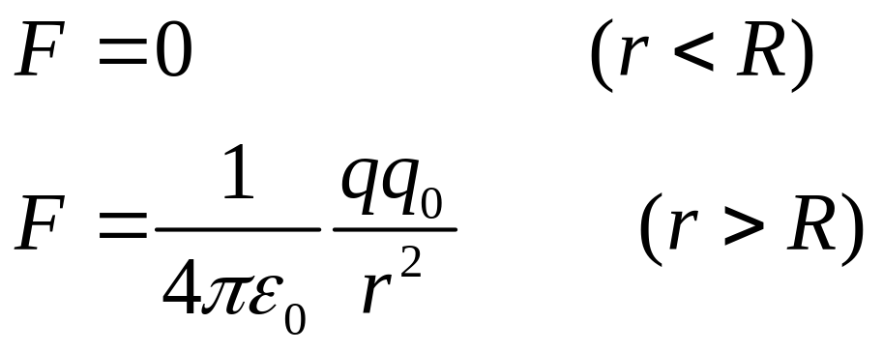
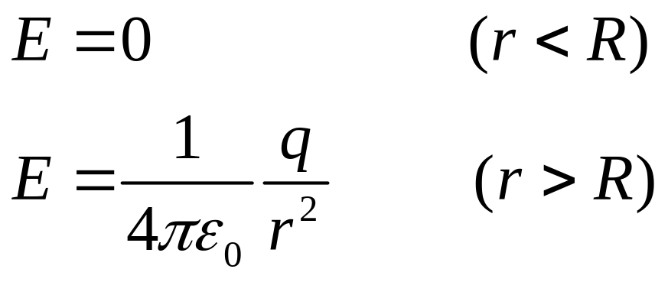
3. A Uniform spherical shell of charge
The shell have radius R and charge q,
R
q

Slide 13
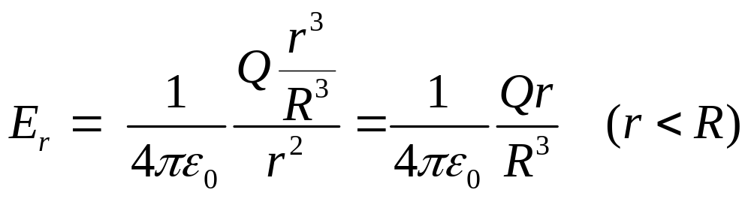

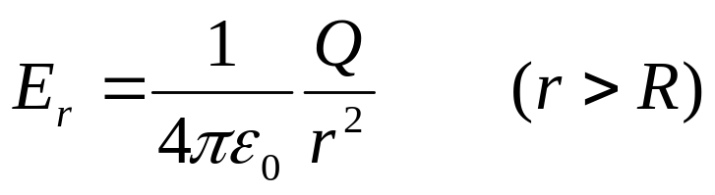



The sphere of radius R and charge Q which distributed uniformly throughout the sphere,
r
r

Slide 14
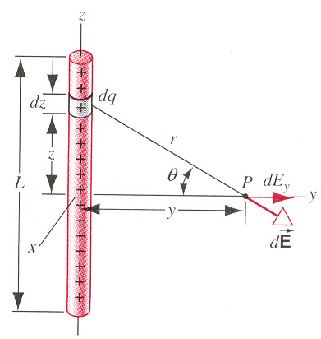
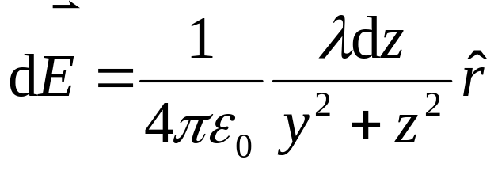
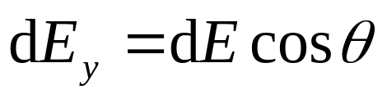
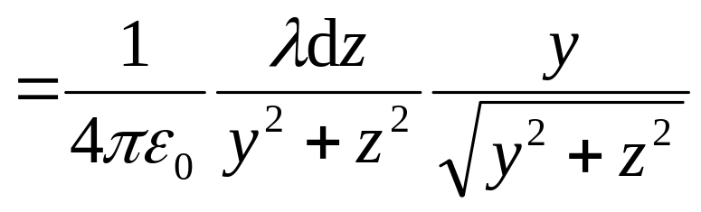
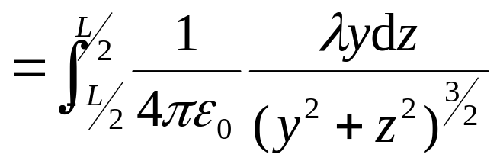
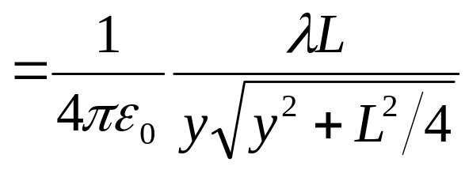
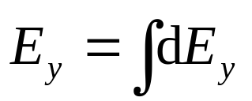
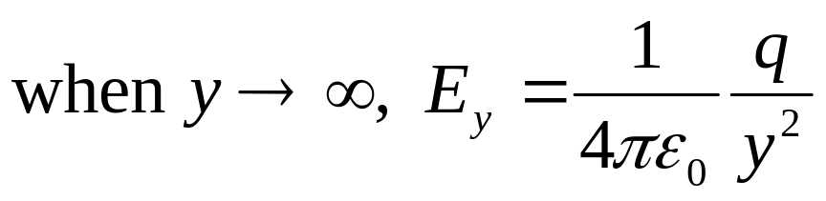
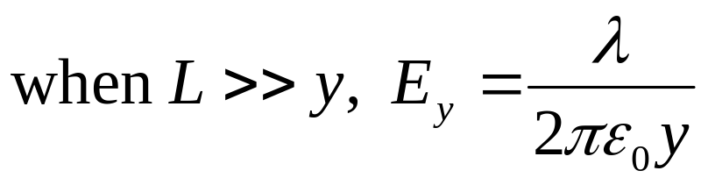
Uniform line of charge
( charged disk becomes a point charge . )

Slide 15


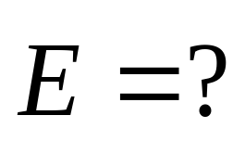
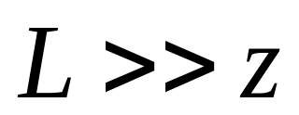




Example — a Plane

Slide 16
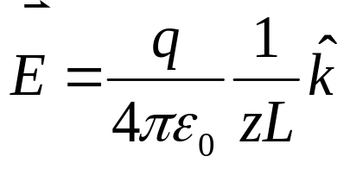

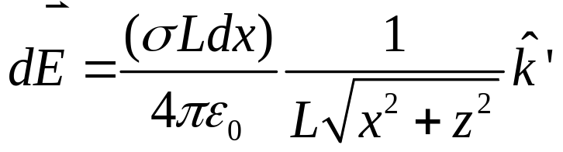
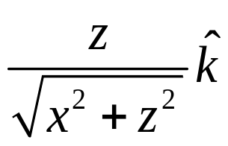
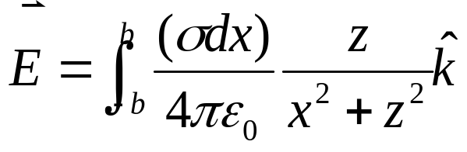
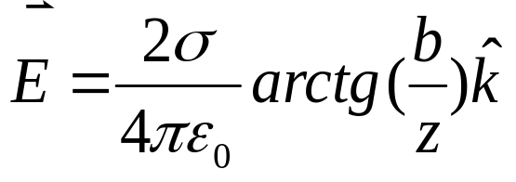


Example — a Plane

Slide 17







The electric dipole :
The configuration of two equal and opposite charges separated by a small distance
The electric property of “electric dipole ” is described by the so-called electric dipole moment :
oxygen
carbon
oxygen
hydrogen
CO
H₂O

Slide 18






The electric field of the electric dipole :

Slide 19



The electric field of the electric dipole :

Slide 20

The electric field of the electric dipole :
1. On the x axis

Slide 21

The electric field of the electric dipole :
2. On the y axis

Slide 22
The electric field lines
To show the magnitude and direction of the electric field
The magnitude of the electric field at any point is the density of field lines

Slide 23

Examples:

Slide 24




The properties of electric field lines:
The electric field line starts on positive charges
but ends on negative charges.
2. The magnitude of the electric field at any point is proportional to the number of field lines per unit cross-sectional area perpendicular to the lines.

Slide 25
The properties of electric field lines:
The electric field line starts on positive charges
but ends on negative charges.
3. The electric field lines do not form the closed curves.
4. Two electric field lines do not intersect with each other at any point in space.
2. The magnitude of the electric field at any point is proportional to the number of field lines per unit cross-sectional area perpendicular to the lines.

Slide 26



A Point Charge in an Electric Field
Measuring the elementary charge—Millikan oil-drop experiment

Slide 27





A Dipole in an Electric Field
A dipole in a uniform electric field

Slide 28






A Dipole in an Electric Field
A dipole in a uniform electric field

Slide 29





Q
A uniform ring of charge
R
Example: find the electric field at point O
O
R/200

Slide 30







A body of continuous charge distribution in electric field
Example: find the force on the charged rod by infinite long line of charge.
λ₁
λ₂
L
L
r
dr

Slide 31
Exercises
P607: 13, 16, 37;
Problems
P609: 6
P610: 8

